Slide 1
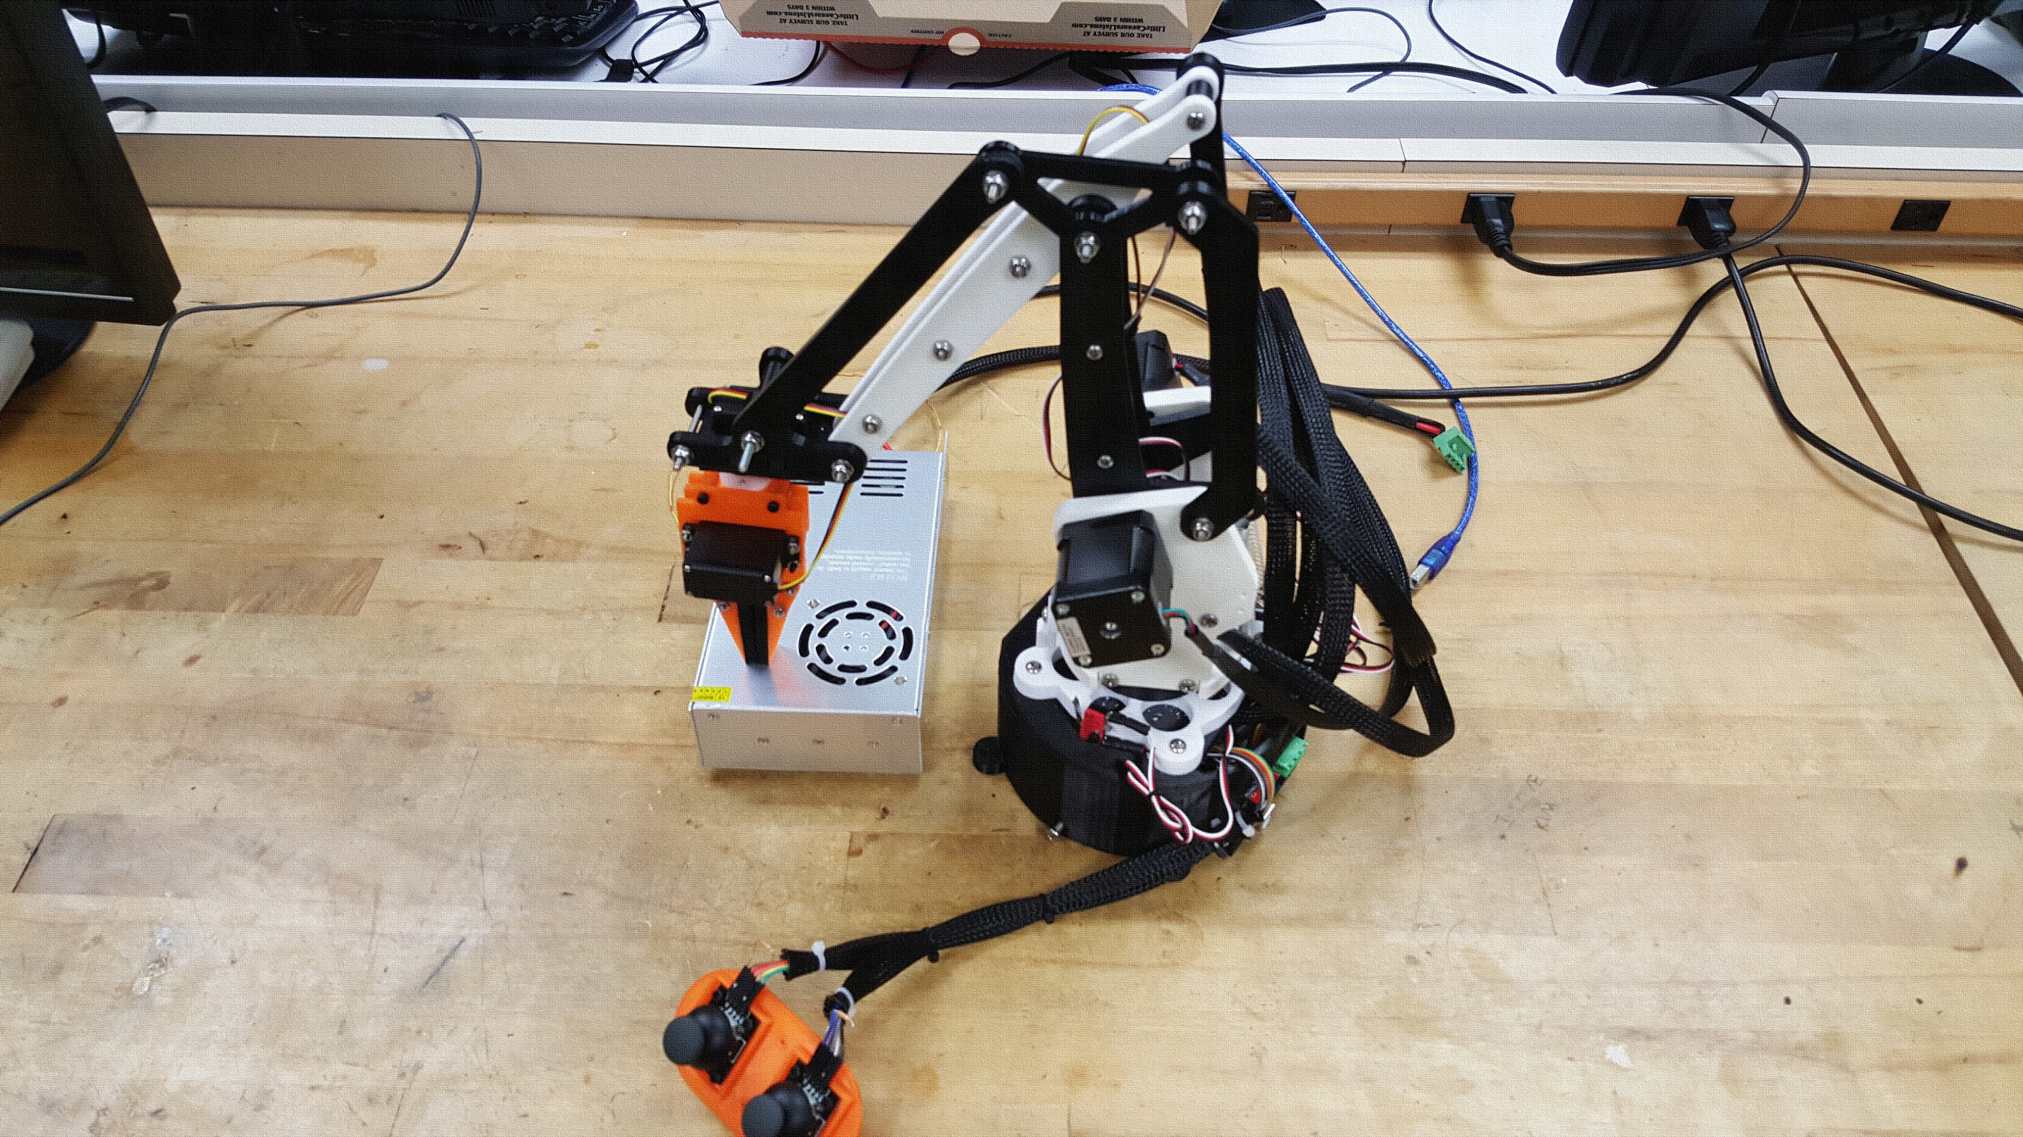
Robotic Arm
EEE 174 Final Project
Thomas Bock, Daniel Komac, Slavik Chiley, Anastasiya Herasimava

Slide 2
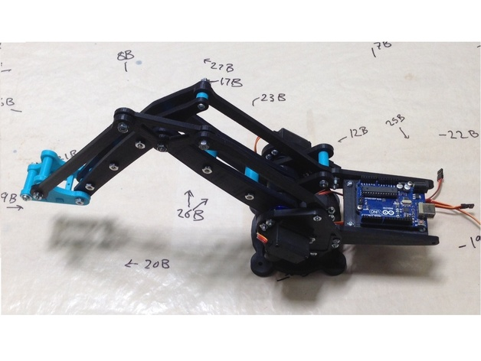
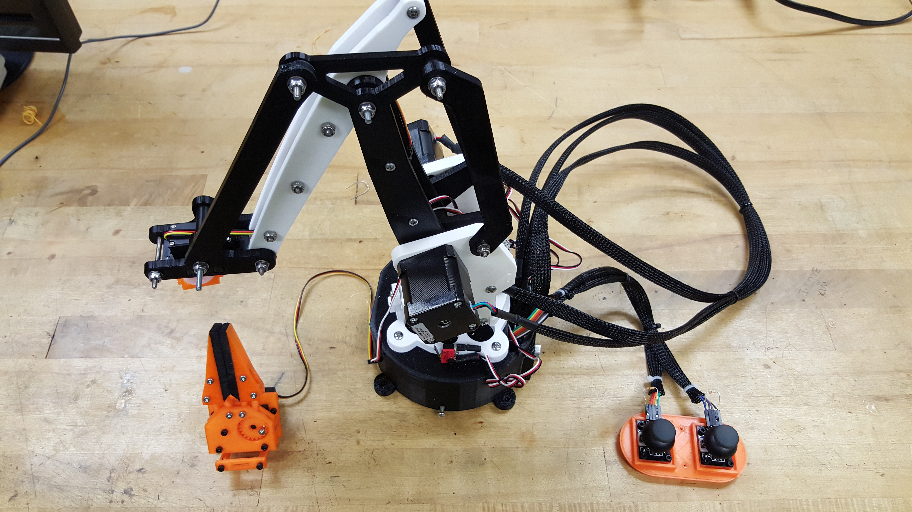
Our robotic arm has been derived from the Lite-Arm i2 design from Thingiverse.com
Lite-Arm i2
EEE 174 Robotic Arm

Slide 3
Project Purpose, Design Goals, and Key Differences
Project Purpose:
Build a palletizing robotic arm that can be used for precise, repetitive tasks, such as a pick and place machine.
Design Goals:
Primary arm control using stepper motors.
Claw control using servo motors.
Joystick Input.
Limit switches to restrain stepper movement.
Original Design:
Primary arm control used servos
No input included in design
No claw control
Limit switches not needed

Slide 4
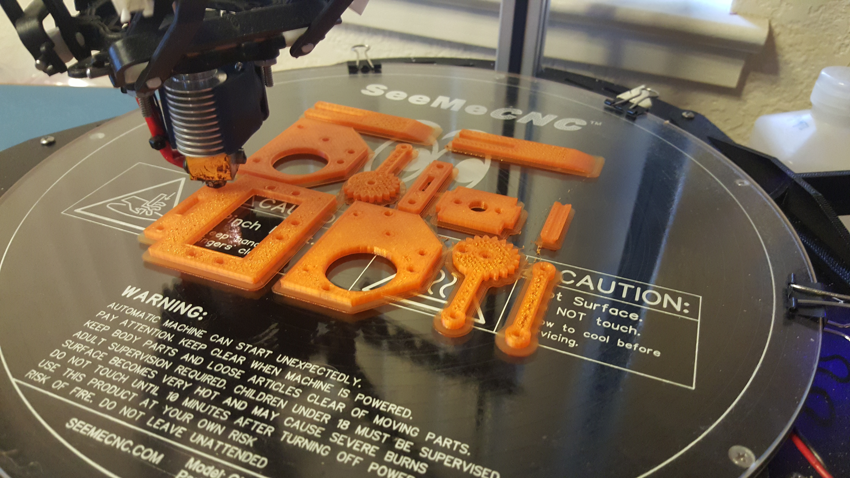
Additional Design Information
Most robotic arm pieces were redesigned to accommodate stepper motors.
All arm pieces were 3d printed.
Gripper arm design is from “Robo Gripper Single Servo Design” on Thingiverse.
New design includes a base to house the electronics with a cooling fan.
The arm is controlled by an Arduino Mega and a RAMPS 1.4 shield.

Slide 5
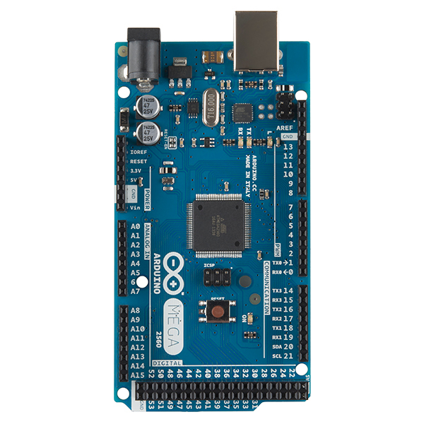
Arduino Mega 2560
The Arduino Uno’s big brother
54 digital I/0 Pins
15 PWM Pins
16 Analog Input Pins

Slide 6
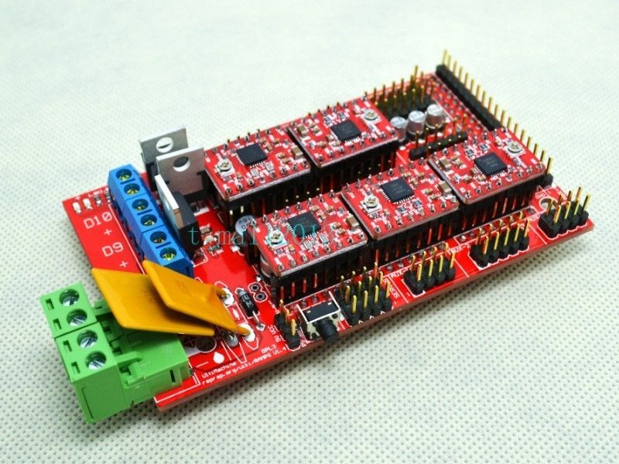
RAMPS 1.4 (Rep-Rap Arduino Mega Pololu Shield)
Shield meant for controlling a 3d Printer
Attaches to the Mega 2560
5 stepper motor outputs
3 limit switch inputs
4 servo outputs

Slide 7
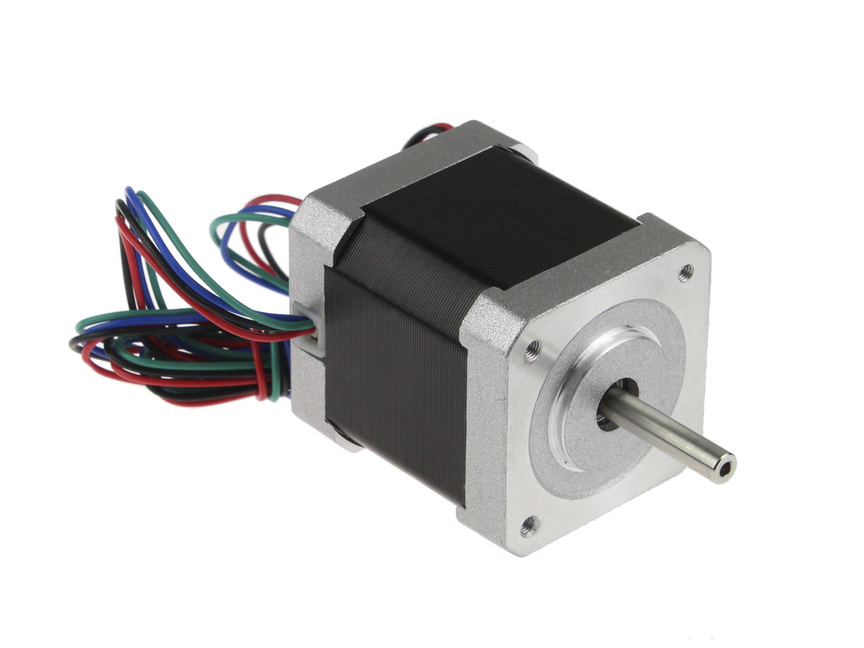
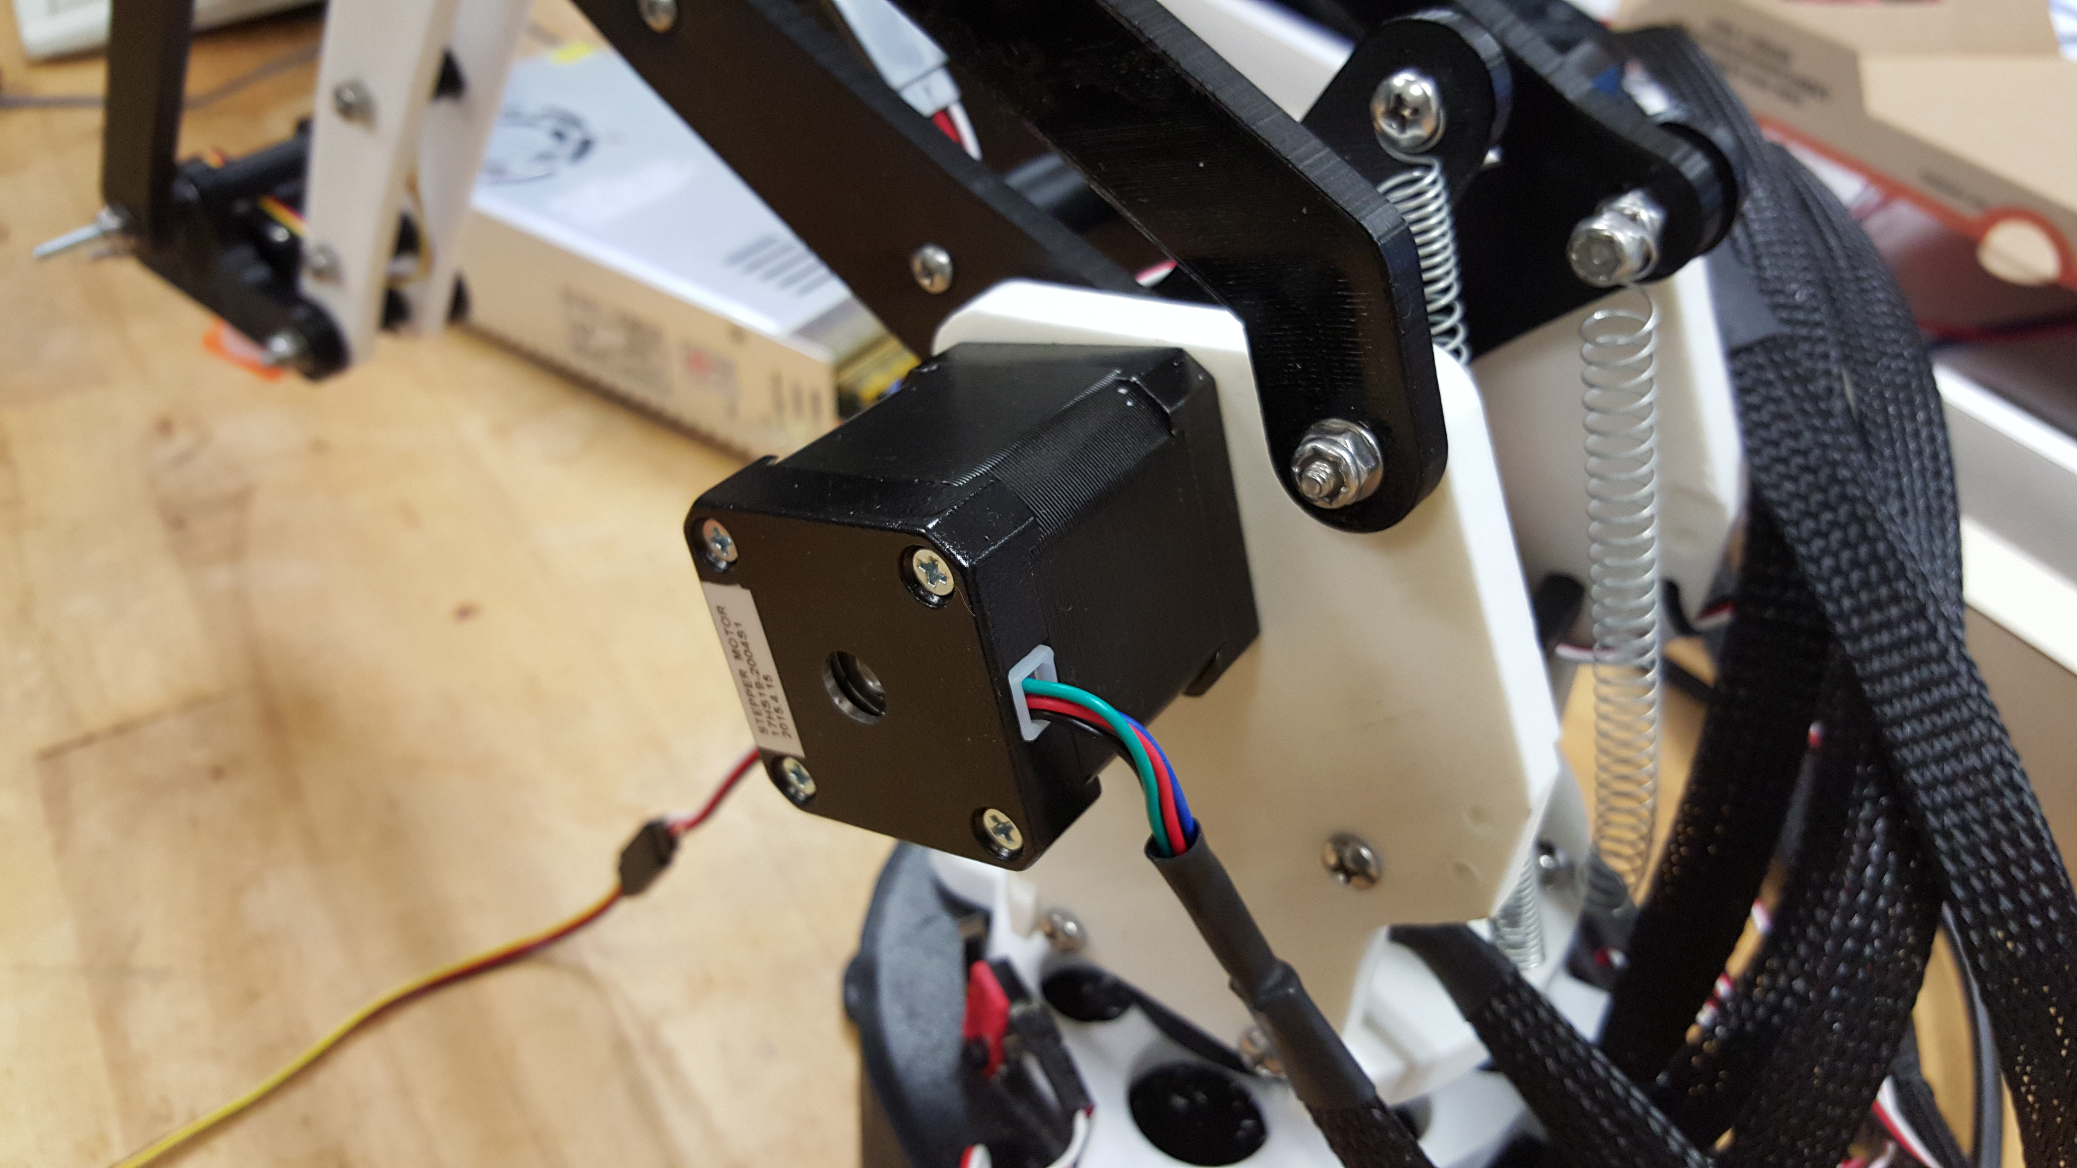
Stepper Motors
Highly Accurate
Used in CNC mills, 3D Printers
Can control rotation down to fractions of a degree
Used to control the movement of the base and arms of the motor
://youtu.be/8b6CCazTScI

Slide 8
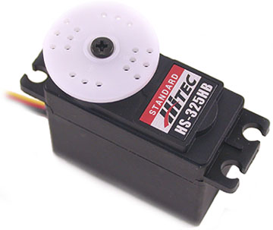
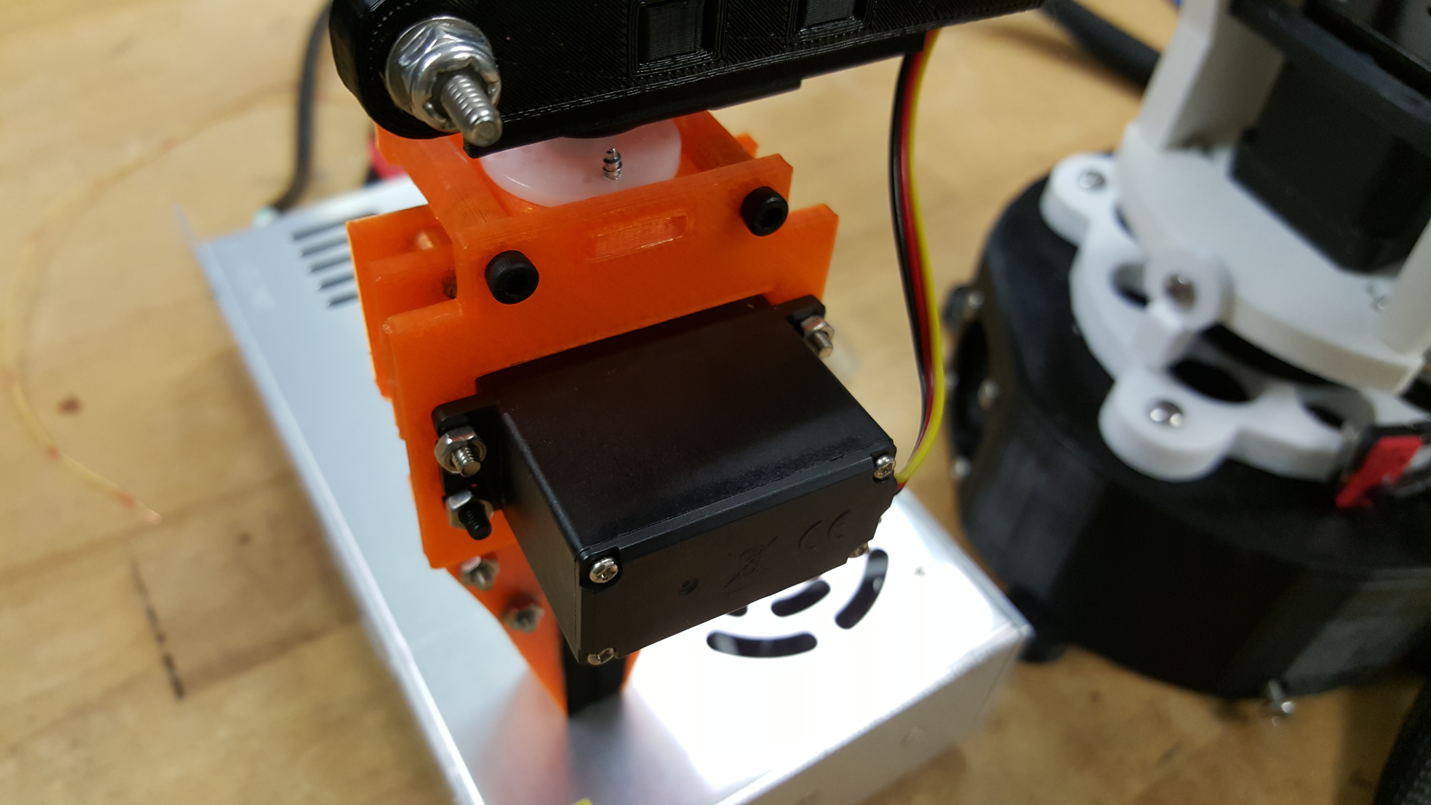
Servo Motors
Very Accurate
Able to set position easily
Small size
Strong torque for size
Used for controlling the gripper arm claws and rotation
https://youtu.be/8nDcadwgRqU?list=PLzwubyoFKp4J31KDuHVLUZdWulLZTxTjZ
https://youtu.be/UkxBGEqDnno?list=PLzwubyoFKp4J31KDuHVLUZdWulLZTxTjZ

Slide 9
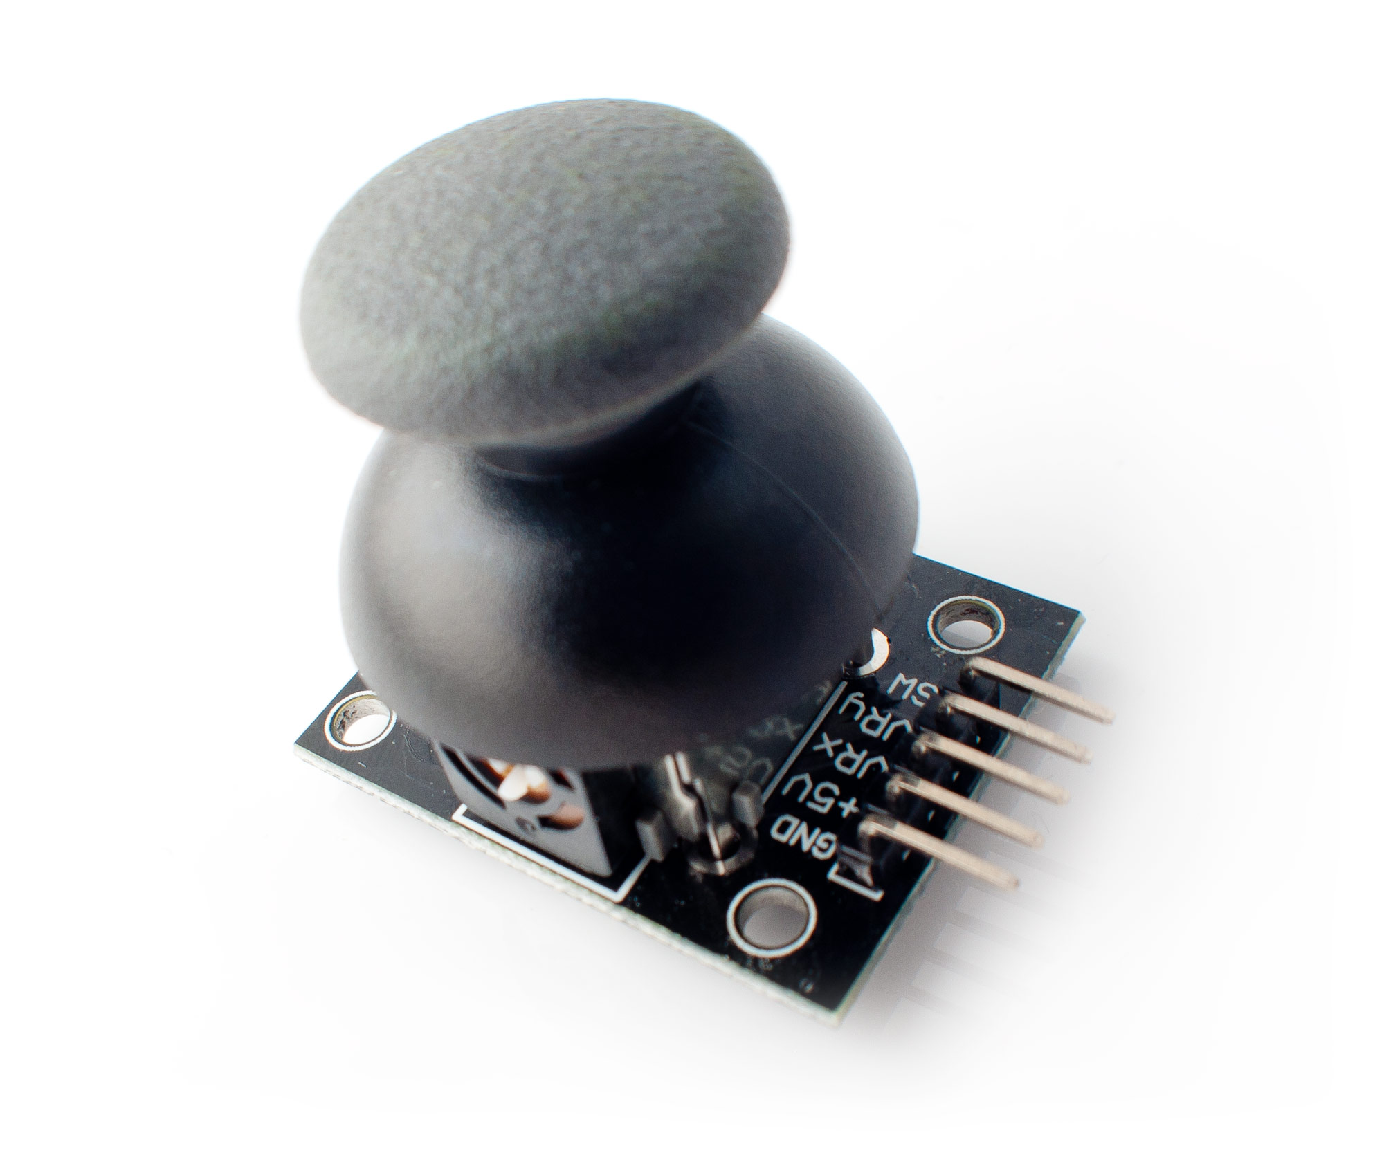
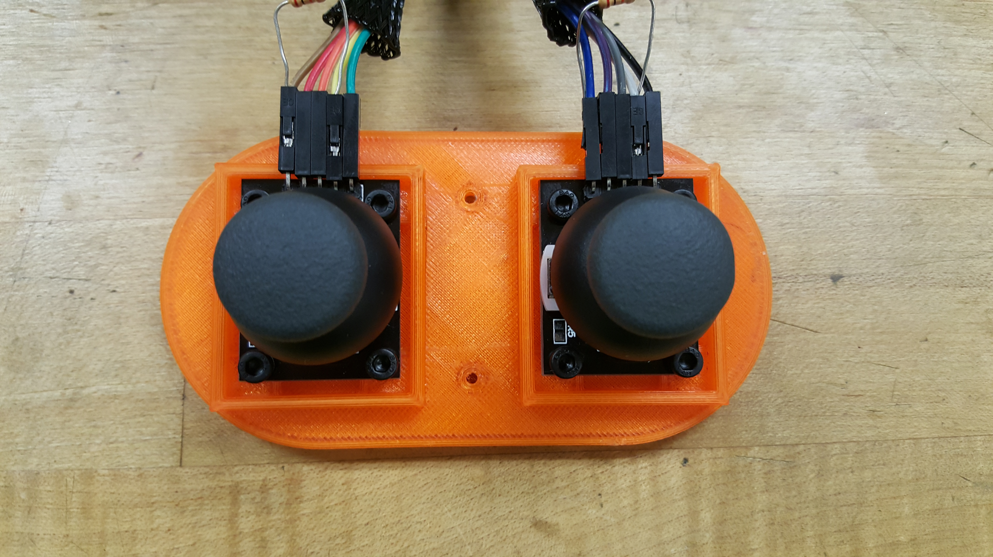
Joysticks
Arduino compatible joysticks
Analog input of joystick X/Y Position
1024 Levels, 512 is center
Pushing down activates button
Used as input for servo motors and stepper motors
https://youtu.be/Cf-M-aqBrDs?list=PLzwubyoFKp4J31KDuHVLUZdWulLZTxTjZ

Slide 10
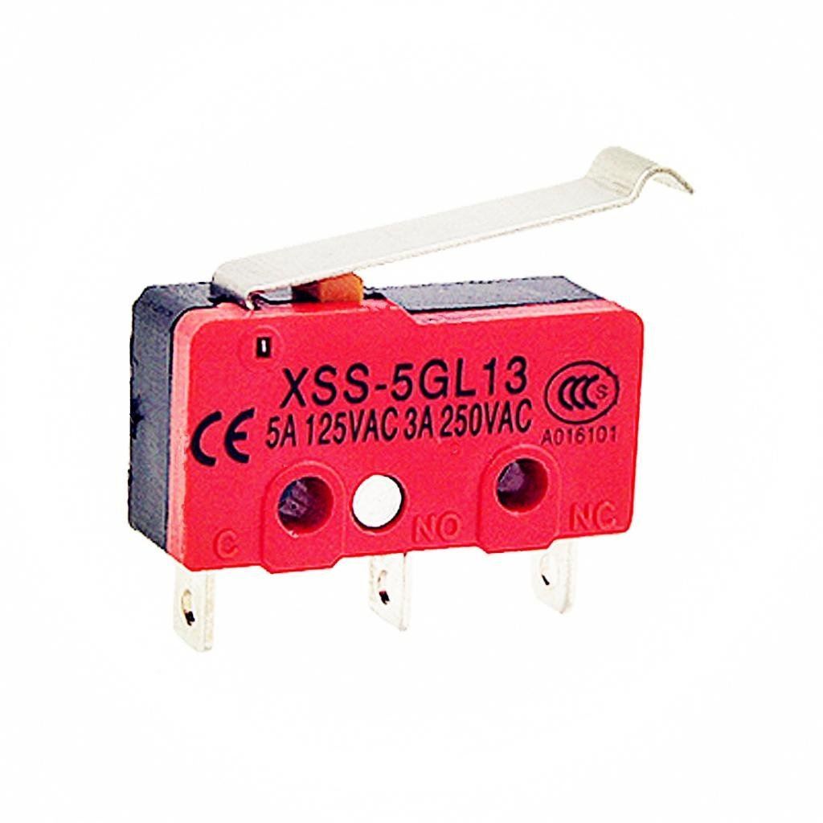
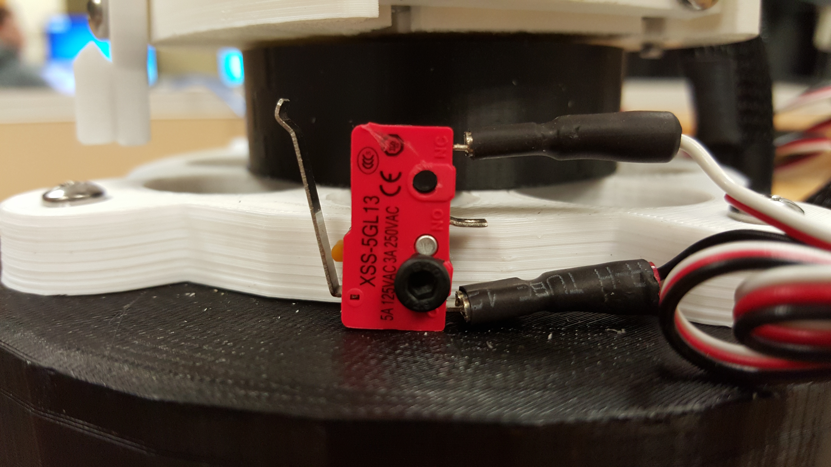
Limit Switches
Switches designed for limiting motor movement.
Have pins for operating with a normally open or normally closed connection
Need pulldown resistors to function
Used to limit rotation of the base.
https://youtu.be/VjsRGGn8_3Y?list=PLzwubyoFKp4J31KDuHVLUZdWulLZTxTjZ

Slide 11
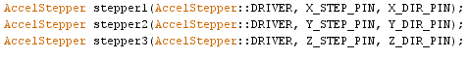
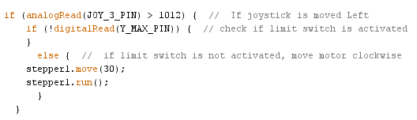
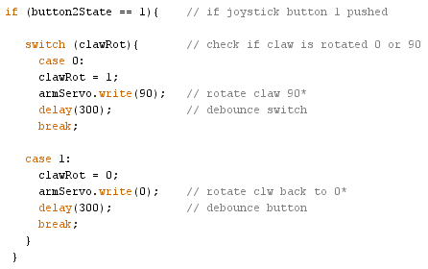
Programming the Arm
The code for controlling the arm is relatively short.
Used servo.h and AccelStepper.h libraries
Most programming problems arose from using the library methods properly and identifying the proper pins used on the RAMPS.

Slide 12
Problems we overcame
Realized the limit switches had to be pulled down and the joystick buttons had to be pulled up.
Able to integrate the servo code with the stepper code.
Figure out how to power the servos on the RAMPS board
Redesign the housing to use stepper motors instead of servo motors
Able to get the arm to move at all.
Figure out usable pins for the joystick input.

Slide 13
Problems that we did not overcome
The stepper motors don’t have enough holding torque to hold up the claw if it is attached. This could be alleviated with more power steppers or some type of gearbox reduction.
The 5v supply on the RAMPS doesn’t have enough power to drive the servos. Our temporary fix was to jumper the 5v supply on the RAMPS with the 5v supply from the Arduino Mega. This kind of works, but the voltage regulator on the Arduino can barely power them as well and is on the brink of burning out. This can be fixed with a new 5v source off of the power supply going through a voltage regulator.

Slide 14
Videos

